Slide 1

AIR Tracker
Automated and Intelligent Recovery of mishandled luggage
a feasibility presentation from CS 410
Green Group
presented by Jeremey Sellen
Wednesday, October 22, 2008
22 October 2008 AIR Tracker <number>

Slide 2


Organizational Chart
22 October 2008 AIR Tracker <number>

Slide 3
Overview
Problem
Solution and Use Cases
Supporting Statistics
What We Will and Will Not Do
Market Analysis
Financial Analysis
Risk Analysis
The Competition
22 October 2008 AIR Tracker <number>

Slide 4
Problem Statement
Due to a lack of proper tracking and quality assurance measures, airlines spend billions of dollars a year on mishandled luggage.¹
DEFINE MISHANDLED
1) Customer Relationship Management (CRM) Daily
22 October 2008 AIR Tracker <number>

Slide 5
Characteristics of the Problem
Lost luggage deters return customers.
Returning lost luggage wastes the time of both
customer and airline.
Superfluous personnel and resources are involved.
Lost luggage costs the airline industry as a whole
$4 billion a year.¹
1) CRM Daily
22 October 2008 AIR Tracker <number>

Slide 6
Facilitating the Tracking Process
AIR Tracker will utilize existing technology at airports in order to
identify bags that have been dropped,
identify bags that have been left behind,
report on the overall baggage handling for each bag,
and pinpoint trouble spots in current baggage handling processes.
22 October 2008 AIR Tracker <number>

Slide 7
Scenario One: A Successful Flight
EXISTING PROCESS FLOW
X # OF BAGS LOST…WHERE? HOW? WHEN?
22 October 2008 AIR Tracker <number>

Slide 8
Scenario Two: A Bag Is Left Behind
EXISTING PROCESS WITH OUR SYSTEM IN
PLACE
22 October 2008 AIR Tracker <number>

Slide 9
Solution Characteristics
Bags That Have Been Dropped
In the traveling process, bags that are dropped (off a cart, for example) will be identified as missing from its proper location.
Bags That Are Left Behind
If a bag is stationary for too long, that bag will be identified as missing from its proper location.
Reports on Overall Baggage Handling
Real-time data will identify if a bag has hit specific checkpoints from check-in until departure.
Trouble Spots in Current Processes
Historical data trends can pinpoint problems in the process and assist airports in better allocating resources.
22 October 2008 AIR Tracker <number>

Slide 10
Lost Luggage Statistics
In July 2007 British Airways lost an average of 28
checked bags per 1000 passengers. ¹
- AEA (Association of European Airlines)
In August 2008, bags were lost at a rate of 8,700 a
day by American based airlines. ²
- U.S. Department of Transportation
1) Seattle PI
2) Office of Aviation Enforcement
22 October 2008 AIR Tracker <number>

Slide 11
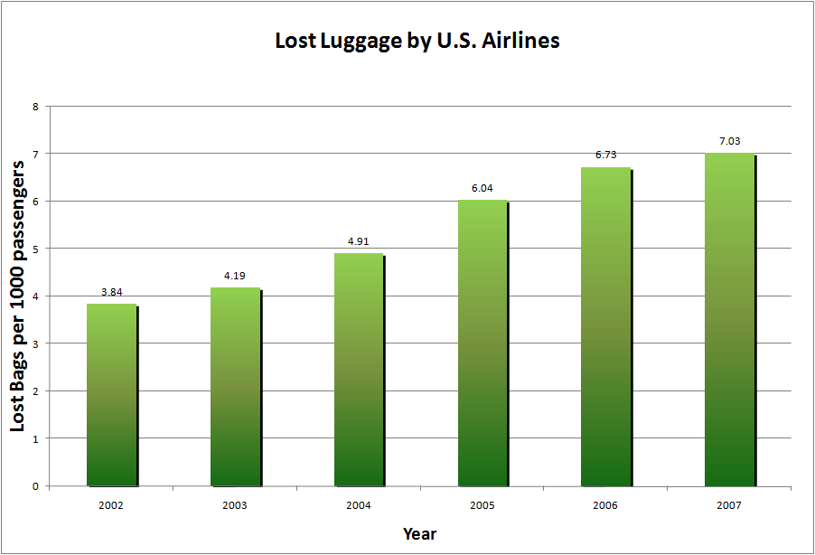
Lost Luggage by U.S. Airlines
22 October 2008 AIR Tracker <number>

Slide 12
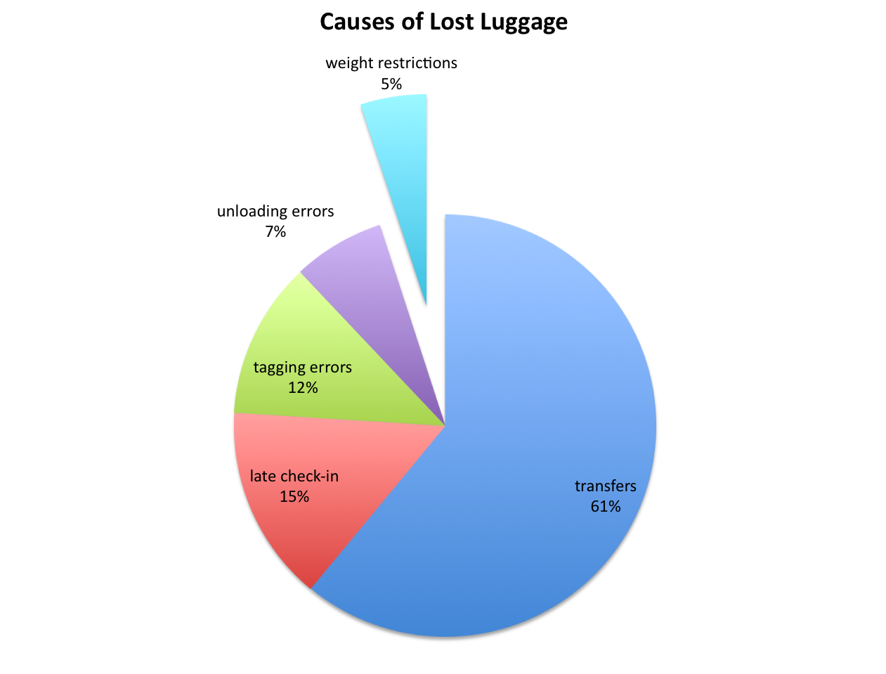
Causes of Lost Luggage
1) Popular Mechanics
22 October 2008 AIR Tracker <number>

Slide 13
What’s in the Box?
APPLICATION SERVER
DATABASE SERVER
SOFTWARE
22 October 2008 AIR Tracker <number>

Slide 14
Major Functional Components Diagram
22 October 2008 AIR Tracker <number>

Slide 15
What We Will Do
We will…
track the routing of the bag through the current baggage handling system.
alert baggage handlers when a bag does not make it to its proper destination.
generate reports on historical trend analysis.
provide software updates as they become available.
22 October 2008 AIR Tracker <number>

Slide 16
What We Will Not Do
We will not…
provide bag tracking information to the traveler.
provide personnel to manage the system.
be responsible for lost or stolen bags.
22 October 2008 AIR Tracker <number>

Slide 17
The Market
“[T]he government’s insistence on only one piece of hand luggage… has put huge strain on the baggage handling staff and, yes, is therefore to blame for the lost luggage.” ¹
- Martin Broughton, ex-Chairman of British Airways
“The primary reason behind mishandled bags is delayed and misconnected flights.” ²
- David A. Castelveter, Air Transport Association spokesman
“The customer is going to keep taking it on the chin.” ³
- Dean Headley, co-author of the 2007 Airline Quality Rating (referencing baggage problems)
“Airports want to meet the demands of travellers by expanding self-service to include the introduction of passenger self-boarding (35%), off-airport passenger/baggage processing (32%) and common bag drop locations (33%).” ⁴
1) Judi Bevan, The Spectator
2) Jonathan Mummolo, Washington Post
3) Jonathan Mummolo, Washington Post
4) Airport IT Trends Survey 2008
22 October 2008 AIR Tracker <number>

Slide 18

Potential Customers
Airports
22 October 2008 AIR Tracker <number>

Slide 19
AIR Tracker Costs
Database Server ~ $6,000 ³
Antennae ~ $13 per unit
Personnel
  Manager ~ $95,000 per year ⁵
  Programmers
  Database Administrator ~ $80,000 per year
  Applications Programmer ~ $85,000 per year
3) sdfsfsdfsdsfd
22 October 2008 AIR Tracker <number>

Slide 20
Pros of Solution
Minimal modifications are needed to existing
systems.
The system identifies human error.
The system saves time when luggage is put onto the
belt loader.
The system will improve current processes.
22 October 2008 AIR Tracker <number>

Slide 21
Cons of Solution
AIR Tracker does not save manpower.
Additional training may be required.
AIR Tracker may have limited functionality without
RFID scanners.
22 October 2008 AIR Tracker <number>

Slide 22
The Competition
Symbol Technologies System
AIR Tracker
attaches to luggage
Yes
Yes
Yes
traceable if sent to
wrong location
Yes
Yes
Yes
traceable if completely lost
No
No
Yes
reusable
Yes
No
Yes
SMS / text message support
Yes
No
Yes
tied to itinerary
Yes
Yes
Yes
supports existing RFID architectures
Yes
Yes
Yes
22 October 2008 AIR Tracker <number>

Slide 23
Conclusion
“If an airline loses a passenger’s bag, you raise the possibility of losing the customer for the long term.” ¹
Billions in lost revenue and wasted man-hours takes away from the customer-oriented business of air travel.
AIR Tracker is the solution!
1) Francesca Levy, Business Week
22 October 2008 AIR Tracker <number>

Slide 24
References
“Air Travel Consumer Reports for 2008.” airconsumer.ost.dot.gov. 30 JUL
2008. Office of Aviation Enforcement. 01 Oct 2008 <http://airconsume
r.ost.dot.gov/reports/atcr08.htm>.
“Airport IT Trends Survey 2008.” sita.aero. SITA. 21 Oct 2008 <http://www
.sita.aero/News_Centre/Industry_surveys_and_trends/Airport_IT_trends
/default.htm>.
Bevan, Judi. “Coping with crisis, climate change — and lost luggage.”
spectator.co.uk. 07 Nov 2007. The Spectator. 20 Oct 2008 <http://ww
w.spectator.co.uk/the-magazine/business/334921/coping-with-crisis-cli
mate-change-and-lost-luggage.html>.
Bicknell, David. “Airlines reject RFID as universal industry solution to
lost bags.” ComputerWeekly.com. 30 Jul 2008. Computer Weekly. 20
Oct 2008 <http://www.computerweekly.com/Articles/2008/06/20/2311
41/airlines-reject-rfid-as-universal-industry-solution-to-lost.htm>.
“Frequently Asked Questions.” globalbagtag.com. Global Bag Tag. 20
Oct 2008 <http://www.globalbagtag.com/faq.cfm>.
Halthore, Mukund. “RE: Contact request from website (Germany).” Email to
Joel Elixson concerning the wholesale cost of GPS/GSM modules. 21 Oct
2008.
“IBM System x3450.” IBM. 2008. IBM. 21 Oct 2008 <http://www-304.ibm.co
m/shop/americas/webapp/wcs/stores/servlet/default/CategoryDisplay
?categoryId=4611686018425232005&storeId=1&catalogId=-840&langId=
1>.
James, Andrea. “Seattle firm sues British Airways over lost luggage.”
Seattle PI. 13 Nov 2007. Seattle PI. 21 Oct 2008 <http://seattlepi.nwso
urce.com/business/339434_lostluggage13.html>.
22 October 2008 AIR Tracker <number>

Slide 25
References
Levy, Francesca. “The Airlines’ Bag Reflex.” BusinessWeek.com. 30 Jul
2008. Business Week. 20 Oct 2008 <http://www.businessweek.com/life
style/content/jul2008/bw20080729_355085.htm>.
Mummolo, Jonathan. “Now Arriving At Carousel 1, Far Fewer Of Your
Bags.” Washingtonpost.com. 01 Oct 2007. Washington Post. 20 Oct 20
08 <http://www.washingtonpost.com/wpdyn/content/article/2007/09
/30/AR2007093001653.html?sid=ST2007100200809>.
“Project Manager, IT Job Salaries in Virginia.” PayScale. 2008. 21 Oct
2008 <http://www.payscale.com/af/calc.aspx?job=project%20manager
&city=Norfolk&state=VA>.
Scottberg, Erin. “Anatomy of Lost Luggage: How to Track Your Bags
(and Save ’Em).” Popular Mechanics. 20 Dec 2007. Popular
Mechanics. 21 Oct 2008 <http://www.popularmechanics.com/technolo
gy/transportation/4237628.html>.
“Software Engineer / Developer / Programmer Job Salaries in Virginia
Beach-Norfolk-Newport News, VA-NC.” PayScale. 2008. 21 Oct 2008
<http://www.payscale.com/af/calc.aspx?job=program mer&city=Norfo
lk&state=VA>.
22 October 2008 AIR Tracker <number>

Slide 26
Questions?
22 October 2008 AIR Tracker <number>

